Slide 1
Data Mining
Data Warehousing

Slide 2
Data Warehousing and OLAP Technology for Data Mining
What is a data warehouse?
A multi-dimensional data model
Data warehouse architecture
Data warehouse implementation
From data warehousing to data mining

Slide 3
What is Data Warehouse?
Defined in many different ways, but not rigorously.
  A decision support database that is maintained separately from the organization’s operational database
  Supports information processing by providing a solid platform of consolidated, historical data for analysis.
“A data warehouse is a subject-oriented, integrated, time-variant, and nonvolatile collection of data in support of management’s decision-making process.”—W. H. Inmon
Data warehousing:
  The process of constructing and using data warehouses

Slide 4
Data Warehouse—Subject-Oriented
Organized around major subjects, such as customer, product, sales.
Focusing on the modeling and analysis of data for decision makers, not on daily operations or transaction processing.
Provide a simple and concise view around particular subject issues by excluding data that are not useful in the decision support process.

Slide 5
Data Warehouse—Integrated
Constructed by integrating multiple, heterogeneous data sources
  relational databases, flat files, on-line transaction records
Data cleaning and data integration techniques are applied.
  Ensure consistency in naming conventions, encoding structures, attribute measures, etc. among different data sources
    E.g., Hotel price: currency, tax, breakfast covered, etc.
  When data is moved to the warehouse, it is converted.

Slide 6
Data Warehouse—Time Variant
The time horizon for the data warehouse is significantly longer than that of operational systems.
  Operational database: current value data.
  Data warehouse data: provide information from a historical perspective (e.g., past 5-10 years)
Every key structure in the data warehouse
  Contains an element of time, explicitly or implicitly
  But the key of operational data may or may not contain “time element”.

Slide 7
Data Warehouse—Non-Volatile
A physically separate store of data transformed from the operational environment.
Operational update of data does not occur in the data warehouse environment.
  Does not require transaction processing, recovery, and concurrency control mechanisms
  Requires only two operations in data accessing:
    initial loading of data and access of data.

Slide 8
Data Warehouse vs. Heterogeneous DBMS
Traditional heterogeneous DB integration:
  Build wrappers/mediators on top of heterogeneous databases
  Query driven approach
    When a query is posed to a client site, a meta-dictionary is used to translate the query into queries appropriate for individual heterogeneous sites involved, and the results are integrated into a global answer set
Data warehouse: update-driven, high performance
  Information from heterogeneous sources is integrated in advance and stored in warehouses for direct query and analysis

Slide 9
Data Warehouse vs. Operational DBMS
OLTP (on-line transaction processing)
  Major task of traditional relational DBMS
  Day-to-day operations: purchasing, inventory, banking, manufacturing, payroll, registration, accounting, etc.
OLAP (on-line analytical processing)
  Major task of data warehouse system
  Data analysis and decision making
Distinct features (OLTP vs. OLAP):
  User and system orientation: customer vs. market
  Data contents: current, detailed vs. historical, consolidated
  Database design: ER + application vs. star + subject
  View: current, local vs. evolutionary, integrated
  Access patterns: update vs. read-only but complex queries

Slide 10

OLTP vs. OLAP

Slide 11
Why Separate Data Warehouse?
High performance for both systems
  DBMS— tuned for OLTP: access methods, indexing, concurrency control, recovery
  Warehouse—tuned for OLAP: complex OLAP queries, multidimensional view, consolidation.
Different functions and different data:
  missing data: Decision support requires historical data which operational DBs do not typically maintain
  data consolidation: DS requires consolidation (aggregation, summarization) of data from heterogeneous sources
  data quality: different sources typically use inconsistent data representations, codes and formats which have to be reconciled

Slide 12
Data Warehousing and OLAP Technology for Data Mining
What is a data warehouse?
A multi-dimensional data model
Data warehouse architecture
Data warehouse implementation
From data warehousing to data mining

Slide 13
Conceptual Modeling of Data Warehouses
Modeling data warehouses: dimensions & measures
  Star schema: A fact table in the middle connected to a set of dimension tables
  Snowflake schema: A refinement of star schema where some dimensional hierarchy is normalized into a set of smaller dimension tables, forming a shape similar to snowflake
  Fact constellations: Multiple fact tables share dimension tables, viewed as a collection of stars, therefore called galaxy schema or fact constellation

Slide 14
Example of Star Schema
time
time_key
day
day_of_the_week
month
quarter
year
item
item_key
item_name
brand
type
supplier_type
Sales Fact Table
time_key
item_key
branch_key
branch
location
location_key
branch_key
branch_name
branch_type
location_key
street
city
province_or_street
country
units_sold
dollars_sold
avg_sales
Measures

Slide 15
Example of Snowflake Schema
time
item
time_key
day
day_of_the_week
month
quarter
year
item_key
item_name
brand
type
supplier_key
supplier
Sales Fact Table
supplier_key
supplier_type
time_key
item_key
branch_key
branch
location
location_key
location_key
street
city_key
branch_key
branch_name
branch_type
units_sold
city
dollars_sold
city_key
city
province_or_street
country
avg_sales
Measures

Slide 16
Example of Fact Constellation
time
time_key
day
day_of_the_week
month
quarter
year
item
Shipping Fact Table
item_key
item_name
brand
type
supplier_type
Sales Fact Table
time_key
time_key
item_key
shipper_key
item_key
branch_key
from_location
branch
location_key
location
to_location
branch_key
branch_name
branch_type
units_sold
location_key
street
city
province_or_street
country
dollars_cost
dollars_sold
units_shipped
avg_sales
shipper
Measures
shipper_key
shipper_name
location_key
shipper_type

Slide 17
Measures: Three Categories
distributive: if the result derived by applying the function to n aggregate values is the same as that derived by applying the function on all the data without partitioning.
    E.g., count(), sum(), min(), max().
algebraic: if it can be computed by an algebraic function with M arguments (where M is a bounded integer), each of which is obtained by applying a distributive aggregate function.
    E.g., avg(), min_N(), standard_deviation().
holistic: if there is no constant bound on the storage size needed to describe a subaggregate.
    E.g., median(), mode(), rank().

Slide 18
A Concept Hierarchy: Dimension (location)
all
all
region
Europe
...
North_America
country
Germany
...
Spain
Canada
...
Mexico
city
Frankfurt
...
Vancouver
...
Toronto
office
L. Chan
...
M. Wind

Slide 19


View of Warehouses and Hierarchies

Slide 20
From Tables and Spreadsheets to Data Cubes
A data warehouse is based on a multidimensional data model which views data in the form of a data cube
A data cube, such as sales, allows data to be modeled and viewed in multiple dimensions
  Dimension tables, such as item (item_name, brand, type), or time(day, week, month, quarter, year)
  Fact table contains measures (such as dollars_sold) and keys to each of the related dimension tables
In data warehousing literature, an n-D base cube is called a base cuboid. The top most 0-D cuboid, which holds the highest-level of summarization, is called the apex cuboid. The lattice of cuboids forms a data cube.

Slide 21
Multidimensional Data
Sales volume as a function of product, month, and region
Dimensions: Product, Location, Time
Hierarchical summarization paths
Region
Industry Region Year
Category Country Quarter
Product City Month Week
Office Day
Product
Month

Slide 22

A Sample Data Cube
Date
Total annual sales
of TV in U.S.A.
1Qtr
2Qtr
3Qtr
4Qtr
sum
Product
TV
PC
U.S.A
VCR
sum
Canada
Country
Mexico
sum
All, All, All

Slide 23
Cuboids Corresponding to the Cube
all
0-D(apex) cuboid
product
date
country
1-D cuboids
product,date
product,country
date, country
2-D cuboids
3-D(base) cuboid
product, date, country

Slide 24
Typical OLAP Operations
Roll up (drill-up): summarize data
  by climbing up hierarchy or by dimension reduction
Drill down (roll down): reverse of roll-up
  from higher level summary to lower level summary or detailed data, or introducing new dimensions
Slice and dice:
  project and select
Pivot (rotate):
  reorient the cube, visualization, 3D to series of 2D planes.
Other operations
  drill across: involving (across) more than one fact table
  drill through: through the bottom level of the cube to its back-end relational tables (using SQL)

Slide 25
Data Warehousing and OLAP Technology for Data Mining
What is a data warehouse?
A multi-dimensional data model
Data warehouse architecture
Data warehouse implementation
From data warehousing to data mining

Slide 26
Multi-Tiered Architecture
Monitor
&
Integrator
OLAP Server
other
sources
Metadata
Analysis
Query
Reports
Data mining
Operational
DBs
Extract
Transform
Load
Refresh
Data
Warehouse
Serve
Data Marts
Data Sources
Data Storage
OLAP Engine
Front-End Tools

Slide 27
Three Data Warehouse Models
Enterprise warehouse
  collects all of the information about subjects spanning the entire organization
Data Mart
  a subset of corporate-wide data that is of value to a specific groups of users. Its scope is confined to specific, selected groups, such as marketing data mart
    Independent vs. dependent (directly from warehouse) data mart
Virtual warehouse
  A set of views over operational databases
  Only some of the possible summary views may be materialized

Slide 28
Data Warehouse Development: A Recommended Approach
Multi-Tier Data Warehouse
Distributed Data Marts
Enterprise Data Warehouse
Data Mart
Data Mart
Model refinement
Model refinement
Define a high-level corporate data model

Slide 29
OLAP Server Architectures
Relational OLAP (ROLAP)
  Use relational or extended-relational DBMS to store and manage warehouse data and OLAP middle ware to support missing pieces
  Include optimization of DBMS backend, implementation of aggregation navigation logic, and additional tools and services
  Greater scalability
Multidimensional OLAP (MOLAP)
  Array-based multidimensional storage engine (sparse matrix techniques)
  Fast indexing to pre-computed summarized data
Hybrid OLAP (HOLAP)
  User flexibility, e.g., low level: relational, high-level: array
Specialized SQL servers
  Specialized support for SQL queries over star/snowflake schemas

Slide 30
Data Warehousing and OLAP Technology for Data Mining
What is a data warehouse?
A multi-dimensional data model
Data warehouse architecture
Data warehouse implementation
From data warehousing to data mining

Slide 31
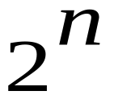
Efficient Data Cube Computation
Data cube can be viewed as a lattice of cuboids
  The bottom-most cuboid is the base cuboid
  The top-most cuboid (apex) contains only one cell
  How many cuboids in an n-dimensional cube?

Slide 32
Problem: How to Implement Data Cube Efficiently?
Physically materialize the whole data cube
  Space consuming in storage and time consuming in construction
  Indexing overhead
Materialize nothing
  No extra space needed but unacceptable response time
Materialize only part of the data cube
  Intuition: precompute frequently-asked queries?
  However: each cell of data cube is an aggregation, the value of many cells are dependent on the values of other cells in the data cube
  A better approach: materialize queries which can help answer many other queries quickly

Slide 33
Motivating example
Assume the data cube:
  Stored in a relational DB (MDDB is not very scalable)
  Different cuboids are assigned to different tables
  The cost of answering a query is proportional to the number of rows examined
Use TPC-D decision-support benchmark
  Attributes: part, supplier, and customer
  Measure: total sales
  3-D data cube: cell (p, s ,c)

Slide 34
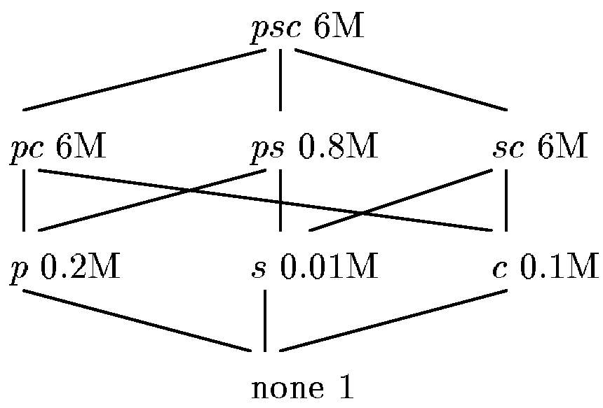
Motivating example (cont.)
Hypercube lattice: the eight views (cuboids) constructed by grouping on some of part, supplier, and customer
Finding total sales grouped by part
Processing 6 million rows if cuboid pc is materialized
Processing 0.2 million rows if cuboid p is materialized
Processing 0.8 million rows if cuboid ps is materialized

Slide 35
Motivating example (cont.)
How to find a good set of queries?
How many views must be materialized to get reasonable performance?
Given space S, what views should be materialized to get the minimal average query cost?
If we are willing to tolerate an X% degradation in average query cost from a fully materialized data cube, how much space can we save over the fully materialized data cube?

Slide 36

Dependence relation
The dependence relation on queries:
Q1 _ Q2 iff Q1 can be answered using only the results of query Q2 (Q1 is dependent on Q2).
In which
  _ is a partial order, and
  There is a top element, a view upon which is dependent (base cuboid)
Example:
  (part) _ (part, customer)
  (part) _ (customer) and (customer) _ (part)

Slide 37
Lattice notation
A lattice with set of elements L and dependance relation _ is denoted by <L, _>
a b means that a _ b, and a ≠ b
ancestor(a) = {b | a _ b }
descendant(a) = {b | b _ a }
next(a) = {b | a b, ∃ c, a c , c b}
Lattice diagrams: a lattice can be represented as a graph, where the lattice elements (views) are nodes and there is an edge from a below b iff b is in next(a).

Slide 38
Hierarchies
Dimensions of a data cube consist of more than one attribute, organized as hierarchies
Operations on hierarchies: roll up and drill down
Hierarchies are not all total orders but partial orders on the dimension:
  Consider the time dimension with the hierarchy day, week, month, and year :
  (month) _ (week) and (week) _ (month)
  Since month (year) can’t be divided by weeks

Slide 39
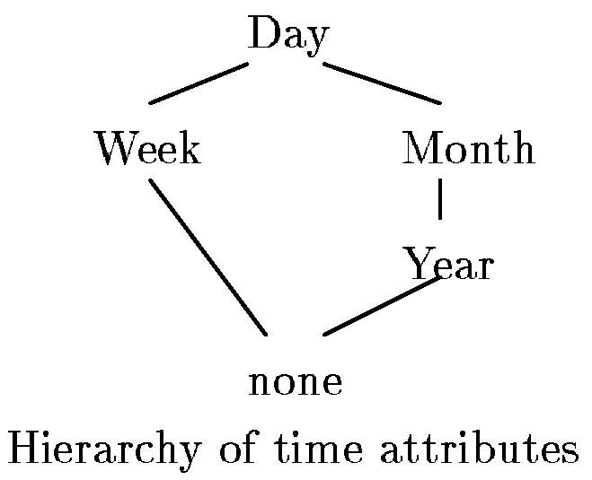
Hierachies (cont.)

Slide 40
The lattice framework:
Composite lattices
Query dependencies can be:
  caused by the interaction of the different dimensions (hypercube)
  within a dimension caused by attribute hierarchies
  across attribute hierarchies of different dimensions
Views can be represented as an n-tuple (a₁, a₂, … ,a_{n}), where a_{i} is a point in the hierachy for the i-th dimension
(a₁, a₂, … ,a_{n}) _ (b₁, b₂, … ,b_{n}) iff a_{i} _ b_{i} for all i

Slide 41
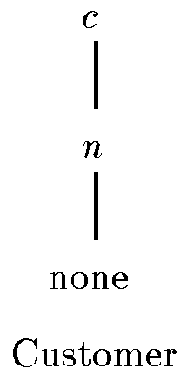
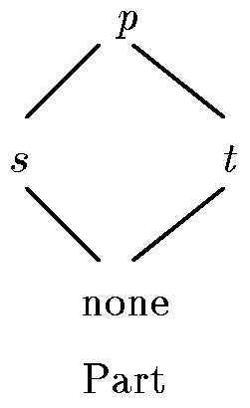
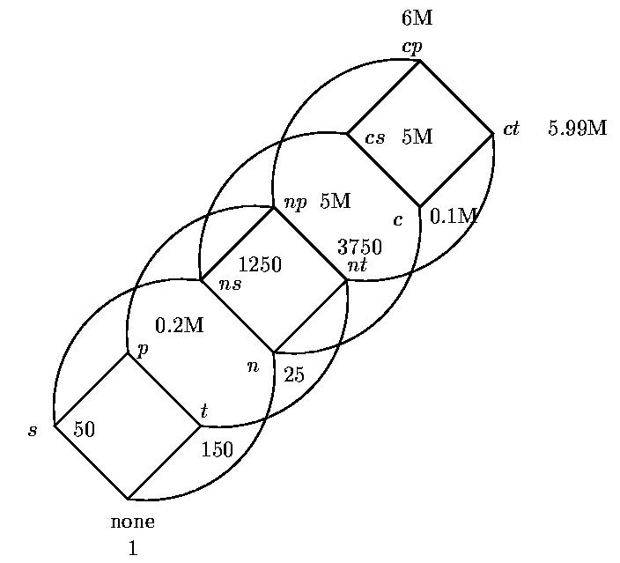
The lattice framework:
Composite lattices (cont.)
Combining two hierarchical dimensions
(n, s) _ (c, s)
Dimension hierarchies
Lattice framework
(Direct-product of lattices)

Slide 42
The advantages of lattice framework
Provide a clean framework to reason with dimensional hierarchies
We can model the common queries asked by users better
Tells us in what order to materialize the views

Slide 43
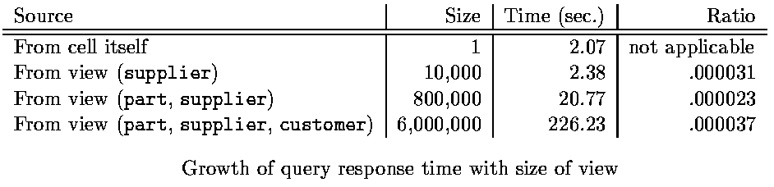
The linear cost model
For <L, _>, Q _ Q_{A}, C(Q) is the number of rows in the table for that query Q_{A} used to compute Q
  This linear relationship can be expressed as:
  T = m * S + c
  (m: time/size ratio; c: query overhead; S: size of the view)
  Validation of the model using TPC-D data:

Slide 44
The benefit of a materialized view
Denote the benefit of a materialized view v, relative to some set of views S, as B(v, S)
For each w _ v, define B_{W} by:
  Let C(v) be the cost of view v
  Let u be the view of least cost in S such that w _ u (such u must exist)
  B_{W} = C(u) – C(v) if C(v) < C(u)
= 0 if C(v) ≥ C(u)
  B_{W} is the benefit that it can obtain from v
Define B(v, S) = Σ _{w < v} B_{w} which means how v can improve the cost of evaluating views, including itself

Slide 45
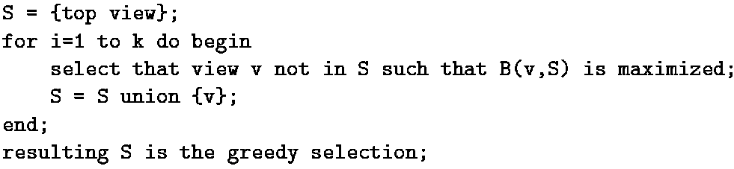
The greedy algorithm
Objective
  Assume materializing a fixed number of views, regardless of the space they use
  How to minimize the average time taken to evaluate a view?
The greedy algorithm for materializing a set of k views
Performance: Greedy/Optimal ≥ 1 – (1 – 1/k) ^{k} ≥ (e - 1) / e

Slide 46
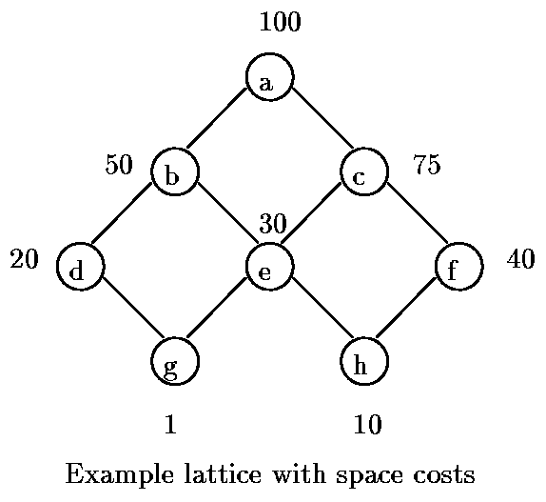
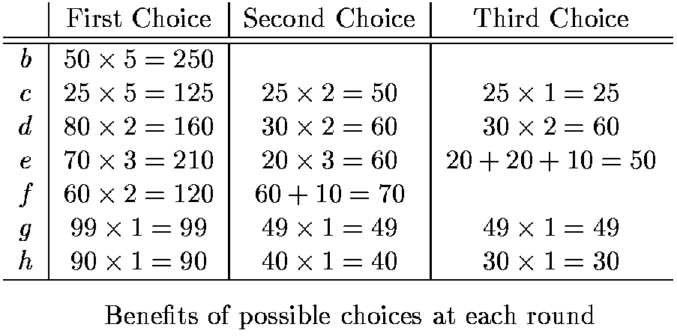
Greedy algorithm: example 1
Suppose we want to choose three views (k = 3)
The selection is optimal (reduce cost from 800 to 420)

Slide 47
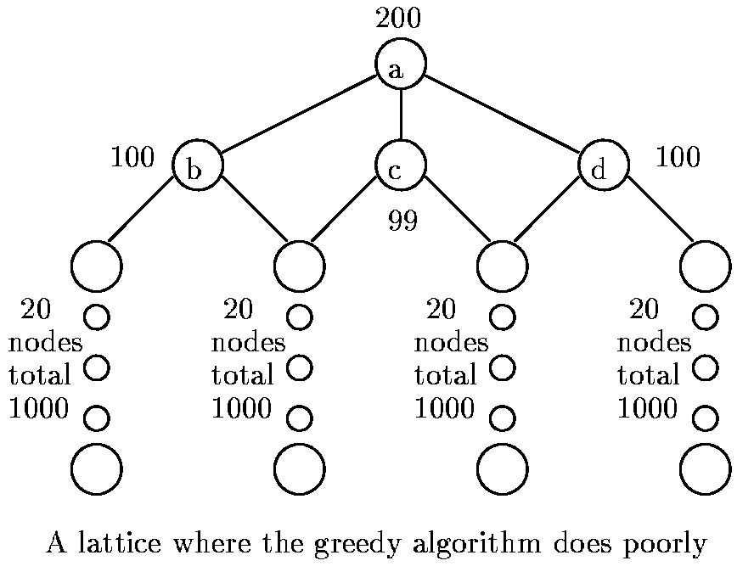
Greedy algorithm: example 2
Suppose k = 2
  Greedy algorithm picks c and b: benefit = 101*41+100*21 = 6241
  Optimal selection is b and d: benefit = 100*41+100*41 = 8200
  However, greedy/optimal = 6241/8200 > 3/4

Slide 48
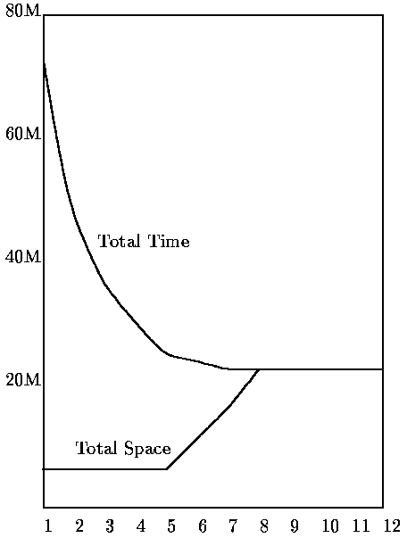
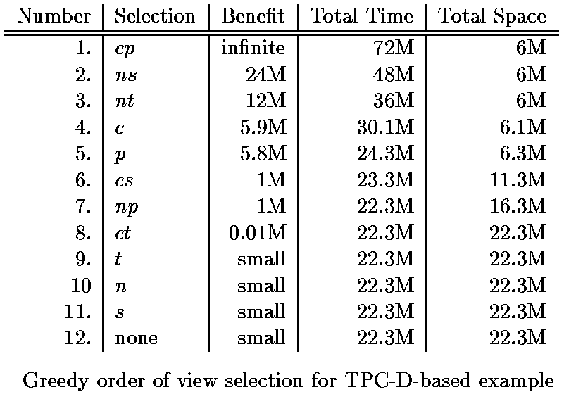
An experiment: how many views should be materialized?
Time and space for the greedy selection for the TPC-D-based example (full materialization is not efficient)
Number of materialized views

Slide 49

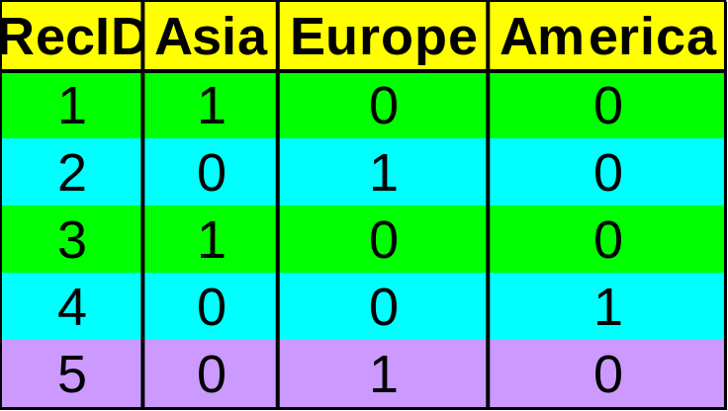

Indexing OLAP Data: Bitmap Index
Index on a particular column
Each value in the column has a bit vector: bit-op is fast
The length of the bit vector: # of records in the base table
The i-th bit is set if the i-th row of the base table has the value for the indexed column
not suitable for high cardinality domains
Base table
Index on Region
Index on Type

Slide 50

Indexing OLAP Data: Join Indices
Join index: JI(R-id, S-id) where R (R-id, …)  S (S-id, …)
Traditional indices map the values to a list of record ids
  It materializes relational join in JI file and speeds up relational join — a rather costly operation
In data warehouses, join index relates the values of the dimensions of a start schema to rows in the fact table.
  E.g. fact table: Sales and two dimensions city and product
    A join index on city maintains for each distinct city a list of R-IDs of the tuples recording the Sales in the city
  Join indices can span multiple dimensions

Slide 51
Efficient Processing of OLAP Queries
Determine which operations should be performed on the available cuboids:
  transform drill, roll, etc. into corresponding SQL and/or OLAP operations, e.g, dice = selection + projection
Determine to which materialized cuboid(s) the relevant operations should be applied.
Exploring indexing structures and compressed vs. dense array structures in MOLAP

Slide 52
Metadata Repository
Meta data is the data defining warehouse objects. It has the following kinds
  Description of the structure of the warehouse
    schema, view, dimensions, hierarchies, derived data defn, data mart locations and contents
  Operational meta-data
    data lineage (history of migrated data and transformation path), currency of data (active, archived, or purged), monitoring information (warehouse usage statistics, error reports, audit trails)
  The algorithms used for summarization
  The mapping from operational environment to the data warehouse
  Data related to system performance
    warehouse schema, view and derived data definitions
  Business data
    business terms and definitions, ownership of data, charging policies

Slide 53
Data Warehouse Back-End Tools and Utilities
Data extraction:
  get data from multiple, heterogeneous, and external sources
Data cleaning:
  detect errors in the data and rectify them when possible
Data transformation:
  convert data from legacy or host format to warehouse format
Load:
  sort, summarize, consolidate, compute views, check integrity, and build indicies and partitions
Refresh
  propagate the updates from the data sources to the warehouse

Slide 54
Data Warehousing and OLAP Technology for Data Mining
What is a data warehouse?
A multi-dimensional data model
Data warehouse architecture
Data warehouse implementation
From data warehousing to data mining

Slide 55
Data Warehouse Usage
Three kinds of data warehouse applications
  Information processing
    supports querying, basic statistical analysis, and reporting using crosstabs, tables, charts and graphs
  Analytical processing
    multidimensional analysis of data warehouse data
    supports basic OLAP operations, slice-dice, drilling, pivoting
  Data mining
    knowledge discovery from hidden patterns
    supports associations, constructing analytical models, performing classification and prediction, and presenting the mining results using visualization tools.
Differences among the three tasks

Slide 56
From On-Line Analytical Processing to On Line Analytical Mining (OLAM)
Why online analytical mining?
  High quality of data in data warehouses
    DW contains integrated, consistent, cleaned data
  Available information processing structure surrounding data warehouses
    ODBC, OLEDB, Web accessing, service facilities, reporting and OLAP tools
  OLAP-based exploratory data analysis
    mining with drilling, dicing, pivoting, etc.
  On-line selection of data mining functions
    integration and swapping of multiple mining functions, algorithms, and tasks.

Slide 57
An OLAM Architecture
Mining query
Mining result
Layer4
User Interface
User GUI API
OLAM
Engine
OLAP
Engine
Layer3
OLAP/OLAM
Data Cube API
Layer2
MDDB
MDDB
Meta Data
Filtering&Integration
Database API
Filtering
Layer1
Data Repository
Data cleaning
Data
Warehouse
Databases
Data integration

Slide 58
Summary
Data warehouse
  A subject-oriented, integrated, time-variant, and nonvolatile collection of data in support of management’s decision-making process
A multi-dimensional model of a data warehouse
  Star schema, snowflake schema, fact constellations
  A data cube consists of dimensions & measures
OLAP operations: drilling, rolling, slicing, dicing and pivoting
OLAP servers: ROLAP, MOLAP, HOLAP
Efficient computation of data cubes
  Partial vs. full vs. no materialization
  Multiway array aggregation
  Bitmap index and join index implementations
Further development of data cube technology
  Discovery-drive and multi-feature cubes
  From OLAP to OLAM (on-line analytical mining)

